Slide 1


Introduction to
Robotic Process Automation
Job Qualification
Automation
ROLL NO : 220701214
NAME : RAJA HAREESH R G
FACULTY NAME : Durai Murugan.N
DEPT :Computer Science and Engineering

Slide 2
Abstract
Efficient course scheduling is a critical yet complex task in academic institutions, often involving the balancing of various constraints, including faculty availability, student preferences, resource allocation, and curriculum requirements. Manual scheduling is time-intensive and prone to conflicts and inefficiencies. This project introduces Course Scheduler Automation, a system designed to streamline and optimize the scheduling process using advanced algorithms and automation techniques.

Slide 3
Need for the Proposed System
Efficiency and Conflict Resolution:Traditional manual course scheduling is time-consuming and error-prone, often resulting in conflicts such as overlapping classes, resource shortages, or faculty overload. The proposed automated system ensures streamlined scheduling, minimizing conflicts and saving significant administrative time.
Scalability and Adaptability: As institutions grow in size and complexity, manual scheduling struggles to accommodate diverse requirements like multiple departments, elective options, and varying faculty and student availability. The proposed system dynamically adapts to these challenges, ensuring scalable and flexible schedule management.

Slide 4
Advantages of the Proposed System
The proposed Course Scheduler Automation System offers several advantages that significantly improve the scheduling process in academic institutions. First, it enhances efficiency by automating time-intensive tasks, reducing the workload on administrative staff, and enabling quicker generation of schedules. It ensures accuracy by minimizing human errors such as overlapping classes, double bookings, or exceeding resource capacities. The system provides flexibility to accommodate last-minute changes, such as faculty unavailability or room adjustments, without disrupting the entire schedule.

Slide 5
Literature Survey
Paper 1 : Automated Scheduling Systems: A Comprehensive Review
Advantage:
Provides detailed insights into existing scheduling algorithms such as genetic algorithms and integer programming.
Highlights the importance of automation in reducing scheduling conflicts and improving resource utilization.
Demonstrates successful implementations in real-world institutions, showcasing significant time and cost savings.
Disadvantages:
Limited focus on scalability for large institutions with highly diverse requirements.
Lack of flexibility in adapting to unique institutional policies and preferences.

Slide 6
Literature Survey
Paper 2 : AI-Based Approaches to Course Scheduling
Advantages:
Explores the use of artificial intelligence and machine learning to predict and optimize scheduling.
Incorporates real-time adaptability, ensuring dynamic updates in response to changes.
Emphasizes improved stakeholder satisfaction by considering student and faculty preferences.
Disadvantages:
High initial development and implementation costs.
Dependence on large datasets for accurate AI predictions, which may not always be available.

Slide 7
Main Objective
The primary objective of the Course Scheduler Automation System is to develop an efficient, user-friendly, and scalable solution that automates the generation of academic schedules while optimizing resource utilization. The system aims to eliminate scheduling conflicts, streamline administrative processes, and ensure compliance with institutional policies, thereby enhancing overall operational efficiency and satisfaction for faculty, students, and administrators.

Slide 8
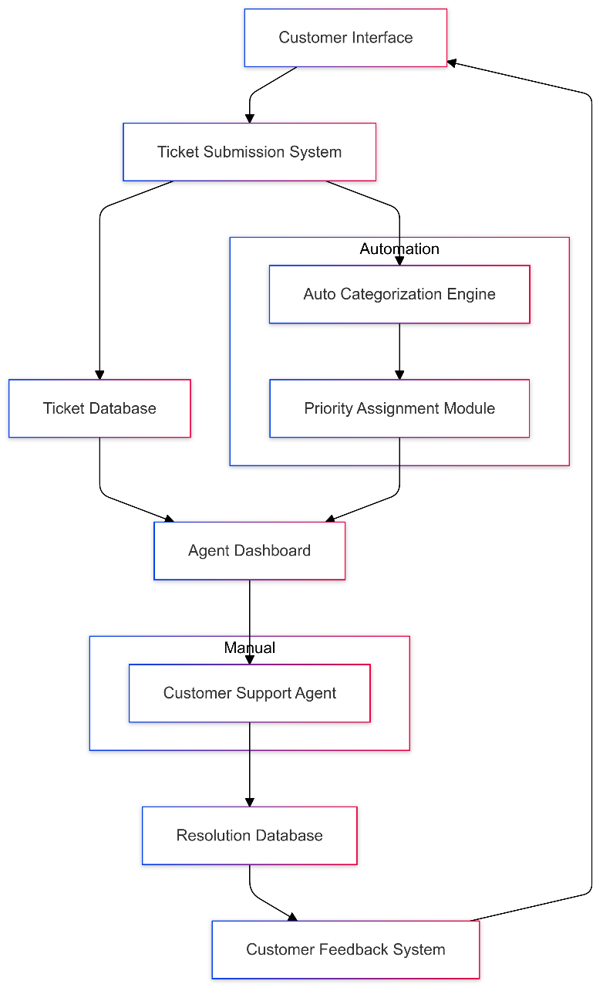
Architecture

Slide 9
System Requirements
1. Hardware Requirements:
Processor: Intel i5 or higher (or equivalent).
RAM: Minimum 8 GB (16 GB recommended for larger datasets).
Storage: At least 256 GB SSD for faster data processing.
Display: Full HD (1920x1080) resolution or higher for better user interface experience.
Peripherals: Keyboard, mouse, and optional printer for report generation.
2. Software Requirements:
Operating System: Windows 10/11, macOS, or Linux.
Development Environment: Visual Studio Code, Eclipse, or any IDE supporting Python/Java.
Database Management: MySQL, PostgreSQL, or MongoDB for data storage.

Slide 10
Functional Description
Module 1:User Management
  This module handles the registration, authentication, and role-based access control for users (admin, faculty, student). It allows users to create accounts, log in securely, update profiles, and manage roles and permissions within the system.
Module 2:Course and Schedule Management
This module allows administrators and faculty to create, update, and manage courses and their schedules. It includes assigning rooms, faculty, and time slots to courses while ensuring conflict-free scheduling based on predefined constraints.

Slide 11
Table Design
1. Users Table
User table: Column Name | Data Type | Description
user_id | INT (Primary Key, Auto Increment) | Unique identifier for users.
name | VARCHAR(100) | Full name of the user.
email | VARCHAR(150) | Email address for login and communication.
password | VARCHAR(255) | Encrypted user password.
role | ENUM('admin', 'faculty', 'student') | Role of the user in the system.

Slide 12
Process Design
Main Process:
Data Collection: Gather input data such as courses, faculty availability, room details, and student enrollment.
Constraint Definition: Define scheduling constraints, such as non-overlapping courses, faculty load limits, room capacities, and department policies.
Sub-Processes:
User Management
Purpose: Manage user accounts and roles (e.g., admin, faculty, student).
Steps:
  User registration and login.
  Assign roles and permissions.
  Manage profile updates.

Slide 13
Implementation
Data Collection: Gather information on courses, faculty availability, room details, and student enrollments through user inputs via the interface.
Database Setup: Create and configure a relational database to store user data, course schedules, room availability, and faculty assignments.
Constraint Definition: Define rules for conflict-free scheduling, including time slots, faculty availability, room capacity, and course prerequisites.
Scheduling Algorithm: Implement optimization algorithms (e.g., genetic algorithm, constraint satisfaction) to generate conflict-free and optimized schedules.
User Interface (UI): Develop an intuitive web or mobile interface for users to input data, view schedules, and interact with the system.

Slide 14
Testing
Unit Testing: Test individual components (e.g., algorithms, database queries) for correctness.
Integration Testing: Ensure different system components (UI, backend, database) work together seamlessly.
Functional Testing: Validate that the system meets functional requirements, such as generating conflict-free schedules.
Performance Testing: Test system performance under heavy loads and ensure scalability.
Usability Testing: Ensure the system is user-friendly and easy to navigate for administrators, faculty, and students.
Security Testing: Verify secure user authentication, data protection, and vulnerability management

Slide 15
Conclusions
The Course Scheduler Automation System offers a robust solution for managing the complexities of academic scheduling in educational institutions. By automating the process of course assignment, room allocation, and conflict resolution, the system significantly reduces the administrative burden, improves operational efficiency, and enhances the overall user experience for both faculty and students. Through the application of advanced algorithms, the system ensures optimized resource utilization and provides real-time adaptability to handle unforeseen changes, such as room unavailability or faculty adjustments.

Slide 16
Future Enhancement
Integration with Learning Management Systems (LMS): Seamlessly connect with platforms like Moodle or Blackboard for real-time course content and schedule updates.
AI-Powered Schedule Optimization: Implement machine learning to predict and optimize schedules based on historical data and usage patterns.
Mobile Application: Develop a dedicated mobile app for students and faculty to view schedules, receive notifications, and make changes on-the-go.
Dynamic Resource Allocation: Allow for automated resource adjustments (e.g., additional classrooms or faculty) based on real-time enrollment changes.
Advanced Reporting Features: Implement advanced analytics and reporting tools to track course demand, faculty workload, and resource usage.
Conflict-Free Student Scheduling: Extend the system to automatically generate student schedules based on course availability, avoiding class overlaps.

Slide 17
References
Rosenkrantz, D. J., Stearns, R. E., & Lewis, L. G. (1974).
The optimization of college course scheduling.
Journal of the ACM, 21(2), 163-177.
This paper discusses early algorithms and approaches for course scheduling optimization.
Pal, R., & Kumar, A. (2016).
A survey on course scheduling techniques in higher education.
Procedia Computer Science, 89, 670-674.
This paper explores various course scheduling methods and optimization strategies.
Schneider, C., & Salama, S. (2017).
Automated scheduling in educational institutions: A review of tools and systems.
International Journal of Computer Applications, 165(5), 23-29.
A comprehensive review of current scheduling systems and the technologies used.

Slide 18
Thank You

